Slide 1
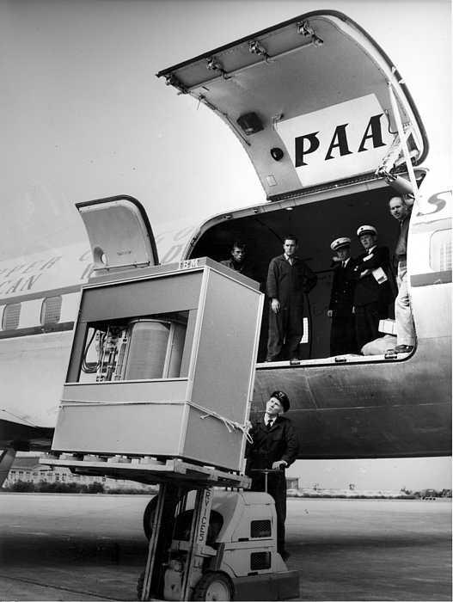
A 5MB Hard Drive from the 1950s
What will today's technology look like in 60 years?
http://t.co/RjzpNoZm

